Slide 1
Department of Master of Computer Applications
Discrete Mathematics and Probability Theory (MMA211TD)
EL Phase-2
RSA Encryption
Kajal Vivek Singh Chauhan (RVCE24MCA017)
Awais Ahmed (RVCE24MCA056)
J Ryan Roy (RVCE24MCA003)
Jatin Saraogi (RVCE24MCA109)

Slide 2
Table of Contents
1. Introduction to RSA Encryption
2. Applications of RSA
3. Example
4. Research Papers

Slide 3
INTRODUCTION TO RSA
Kajal Vivek Singh Chauhan (RVCE24MCA017)
A Discrete Mathematics Perspective
"In a world where data is the new currency, RSA encryption is the vault that keeps it safe!

Slide 4
Introduction
Why Encrypt?
In an increasingly digital world, information security is paramount.
Encryption is the process of transforming data into an unreadable format, protecting it from unauthorized access.
It's essential for safeguarding sensitive information like financial transactions, personal data, and confidential communications.

Slide 5
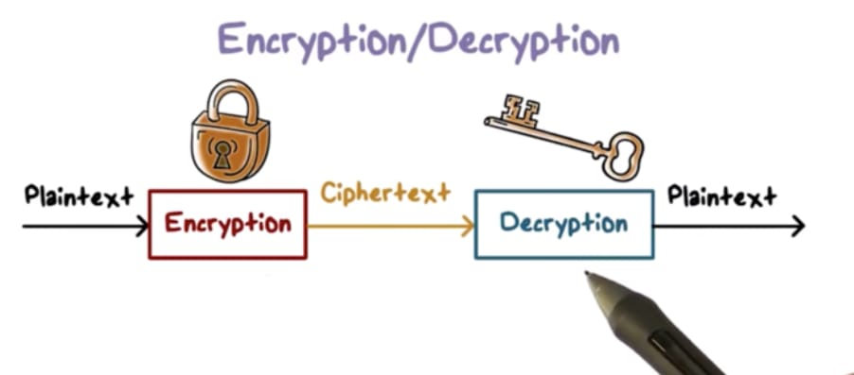
Introduction
Understanding the Basics
Plaintext: The original, readable message.
Ciphertext: The encrypted, unreadable message.
Key: A secret piece of information used to encrypt and decrypt data.
Algorithm: The mathematical process used to perform encryption and decryption.

Slide 6
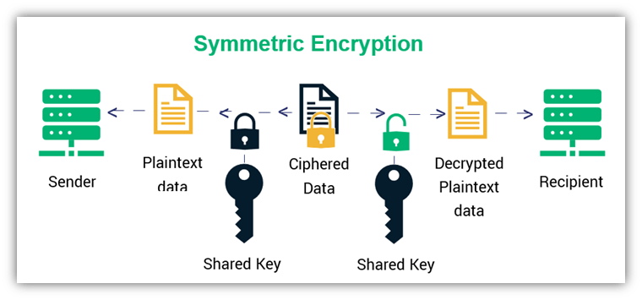
Introduction
Symmetric Encryption: The Shared Secret and the Exchange Problem
Symmetric encryption uses the same key for both encryption and decryption.
It's fast and efficient, ideal for encrypting large amounts of data.
Examples include AES (Advanced Encryption Standard).

Slide 7
Introduction
The Key Exchange Problem
Key Distribution Problem: The most significant drawback is the need to securely share the secret key between parties. This is a challenge, especially over unsecured channels.
Scalability Issues: In large networks, managing and distributing numerous unique keys for every pair of communicators becomes complex and impractical.
Lack of Non-Repudiation: Symmetric encryption doesn't provide non-repudiation, meaning a sender can deny sending a message since they share the same key as the receiver.
Limited Key Lifespan: Keys should be changed regularly, adding to the complexity of key management and distribution.

Slide 8
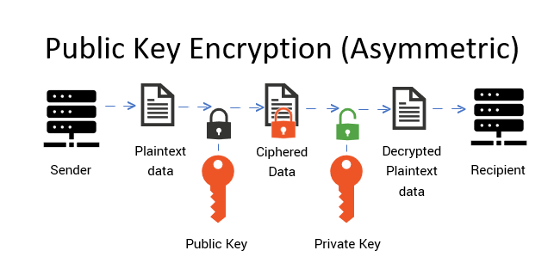
Introduction
Asymmetric Encryption: A New Paradigm
Asymmetric encryption uses two related keys: a public key and a private key.
The public key can be shared with anyone, while the private key must be kept secret.
Data encrypted with the public key can only be decrypted with the corresponding private key, and vice versa.

Slide 9
Introduction
RSA: The Foundation of Modern Security
RSA (Rivest Shamir Adleman) utilizes a pair of mathematically linked keys: a public key (shared freely) and a private key (kept secret).
Messages are encrypted using the recipient's public key. Anyone can encrypt a message with this key.
Only the holder of the corresponding private key can decrypt the message.
RSA's security relies on the difficulty of factoring the product of two large prime numbers, which are used to generate the keys.
The public and private keys are generated through complex mathematical operations involving prime numbers, ensuring that deriving the private key from the public key is computationally infeasible.

Slide 10
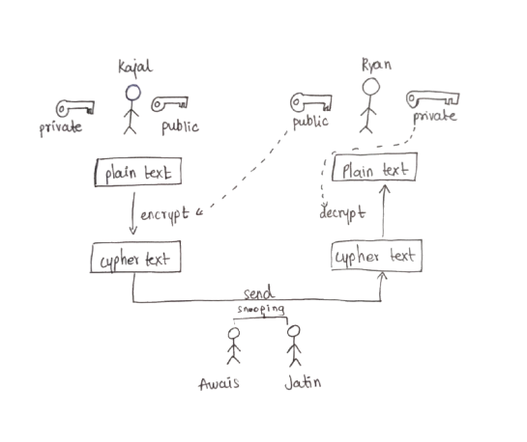
Introduction
Working of RSA Encryption

Slide 11
Introduction
From Theory to Practice
RSA encryption is the backbone of many secure online transactions.
It is used in digital signatures, secure websites, and many other applications.
Next, we will explore the practical applications of RSA in our daily lives.

Slide 12
APPLICATIONS OF RSA
Jatin Saraogi (RVCE24MCA109)
A Discrete Mathematics Perspective
"In a world where data is the new currency, RSA encryption is the vault that keeps it safe!

Slide 13
A Secure Web Communications (HTTPS & SSL/TLS)
TRSA encrypts data in SSL/TLS protocols for secure browsing.
Used in HTTPS websites to protect user data.
Ensures data integrity and confidentiality.

Slide 14
Digital Signatures
RSA enables authentication and non-repudiation.
Used in signing documents and emails.
The sender encrypts a hash with a private key; the receiver verifies it using the sender’s public key.

Slide 15
Secure Email Communication
PGP (Pretty Good Privacy) uses RSA for email encryption.
Ensures only intended recipients can read messages.
Prevents eavesdropping and tampering.
.

Slide 16
BlockChain & CryptoCurrencies
RSA is used for secure key management in blockchain.
Public and private keys control cryptocurrency wallets.
Provides secure transactions and ownership verification.

Slide 17
Password Protection & Communication
Used in password storage and authentication systems.
RSA helps secure login mechanisms with multi-factor authentication (MFA).
Protects user credentials in online services.
.

Slide 18
Secure File Transfer & Cloud Security
RSA ensures safe file transfer between systems (SFTP).
Protects cloud-stored data using end-to-end encryption.
Used in Google Drive, OneDrive, and Dropbox.

Slide 19
Government and Military Security
Optimization: Chinese Remainder Theorem (CRT) for Faster Decryption
RSA encryption secures classified government communications.
Used in defense, intelligence agencies, and secure diplomatic channels.
Protects national security data from cyber threats.

Slide 20
EXAMPLE CODE
Awais Ahmed (RVCE24MCA056)
A Discrete Mathematics Perspective
"In a world where data is the new currency, RSA encryption is the vault that keeps it safe!

Slide 21
SURVEY ON RESEARCH PAPERS
J Ryan Roy (RVCE24MCA003)
A Discrete Mathematics Perspective
"In a world where data is the new currency, RSA encryption is the vault that keeps it safe!

Slide 22
A First Successful Factorization of RSA-2048 Integer by D-Wave Quantum Computer
By Chao Wang, Jingjing Yu, Zhi Pei, Qidi Wang, and Chunlei Hong
Joint International Research Laboratory of Specialty Fiber Optics and Advanced Communication, Shanghai University, Shanghai, China

Slide 23
A First Successful Factorization of RSA-2048 Integer by D-Wave Quantum Computer
This paper discusses the security of RSA encryption and the growing threat posed by quantum computing.
The RSA algorithm relies on the difficulty of prime factorization, but advancements in quantum computing could weaken its security.

Slide 24
A First Successful Factorization of RSA-2048 Integer by D-Wave Quantum Computer
Quantum annealing (QA)
QA leverages quantum tunneling to escape local optima and find the global solution with higher probability.

Slide 25
A First Successful Factorization of RSA-2048 Integer by D-Wave Quantum Computer
Quantum annealing (QA)
QA leverages quantum tunneling to escape local optima and find the global solution with higher probability.
It was successfully used to factorize a 2048-bit RSA integer, marking a major breakthrough in cryptography and quantum computing.

Slide 26
The Mathematical Principles of RSA Encryption Algorithm
Kun Zhang
Cyber Security Academy Shandong University of Political Science and Law Ji Nan, China

Slide 27
The Mathematical Principles of RSA Encryption Algorithm
Requirements for Secure RSA
Computational infeasibility of deriving private key d from public key (n, e).
Size limitation: The plaintext x must be smaller than n.
Efficient computation: Modular exponentiation must be optimized.
Multiple key pairs per n: Prevents brute-force attacks.

Slide 28
The Mathematical Principles of RSA Encryption Algorithm
Optimization: Fast Modular Exponentiation
Naïve approach: Computing x^e directly is inefficient (exponential complexity).
Square-and-Multiply Algorithm:
Convert exponent e to binary.
Use repeated squaring and multiplication to optimize exponentiation.
Reduces operations from O(e) to O(log e).

Slide 29
The Mathematical Principles of RSA Encryption Algorithm
Optimization: Chinese Remainder Theorem (CRT) for Faster Decryption
Knowing p and q, we compute: xp=ydmod p,xq=ydmod qx_p = y^d \mod p, \quad x_q = y^d \mod qxp​=ydmodp,xq​=ydmodq
Using CRT, reconstruct x mod n, reducing decryption time by nearly 4×.

Slide 30
Optimized-Memory and Enhanced-Security Approaches to RSA and ElGamal
Maheswer Sunil Kumar, Vinithra Balaji, Sandosh Sakkarapani.
School of computer Science and Engineering Vellore Institute of Technology Chennai, India

Slide 31
Optimized-Memory and Enhanced-Security Approaches to RSA and ElGamal
This paper presents two improvements to RSA and ElGamal encryption methods:
Reduced Memory Technique
Enhanced Security with Reduced Memory

Slide 32
Optimized-Memory and Enhanced-Security Approaches to RSA and ElGamal
Hashmap-Based Memory Optimization – Reduces memory usage by mapping keys and encrypted data efficiently, making these algorithms more suitable for resource-constrained environments.
Array Manipulation for Enhanced Security – Introduces a third key (modulus and increment value) to manipulate an array storing encryption keys. This increases ciphertext complexity, making decryption harder for attackers.

Slide 33
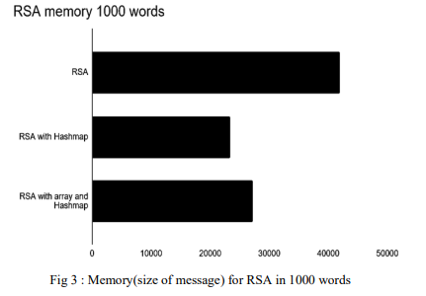
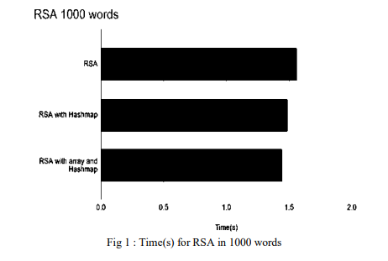
Optimized-Memory and Enhanced-Security Approaches to RSA and ElGamal

